Slide 1

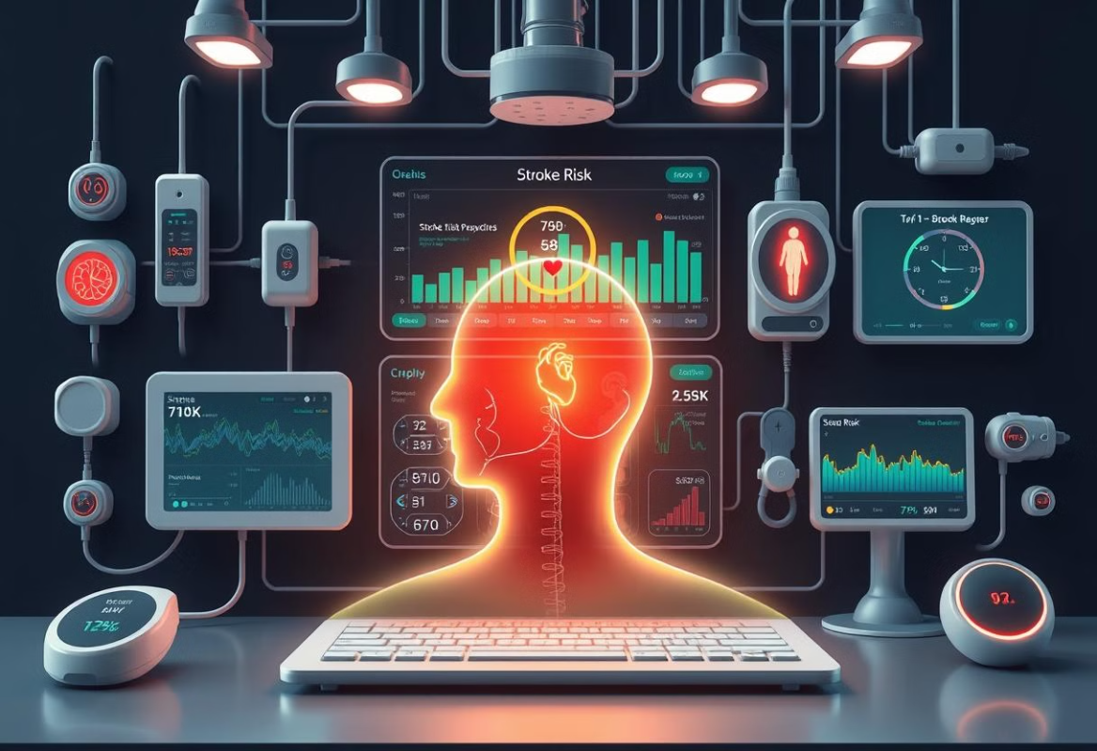

Predicting Cerebrovascular stroke disease related to Heart Disease.
Supervised by: Dr. Hussam Elbehiery

Slide 2
Project’s Team
Name | Department
Ahmed Yasser EL Sharkawy | AI
Ibrahim Ehab Hassan | AI
Ahmed Mohamed Gad Al Mawla | AI
Ahmed Ali Ali Abd Elshafy | AI
Ahmed Amr Afte Deghedy | AI
Arwaa Mohamed Hassan | CS
Sohila Wessam Hamed Refaie | CS
Afnan Fekry Moahmoud Hammad | IS

Slide 3


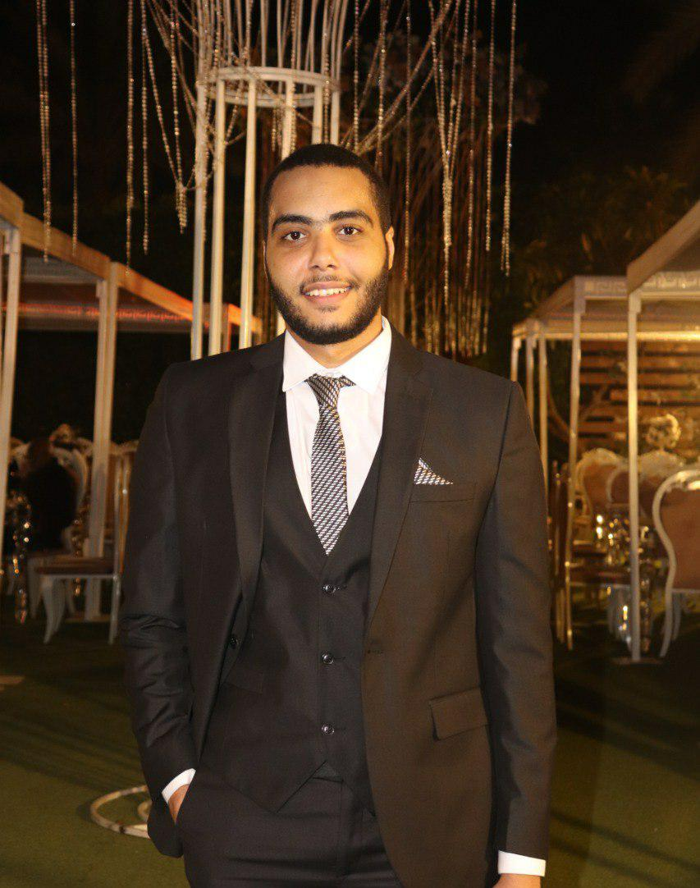
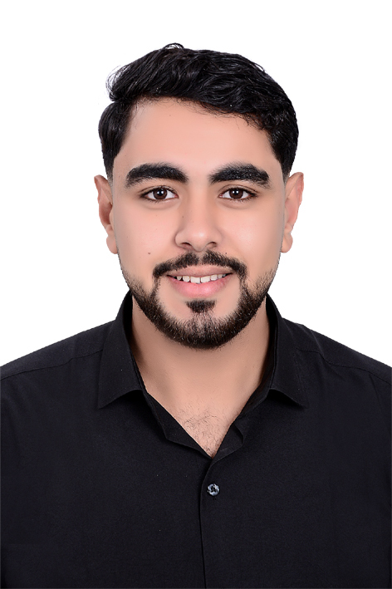
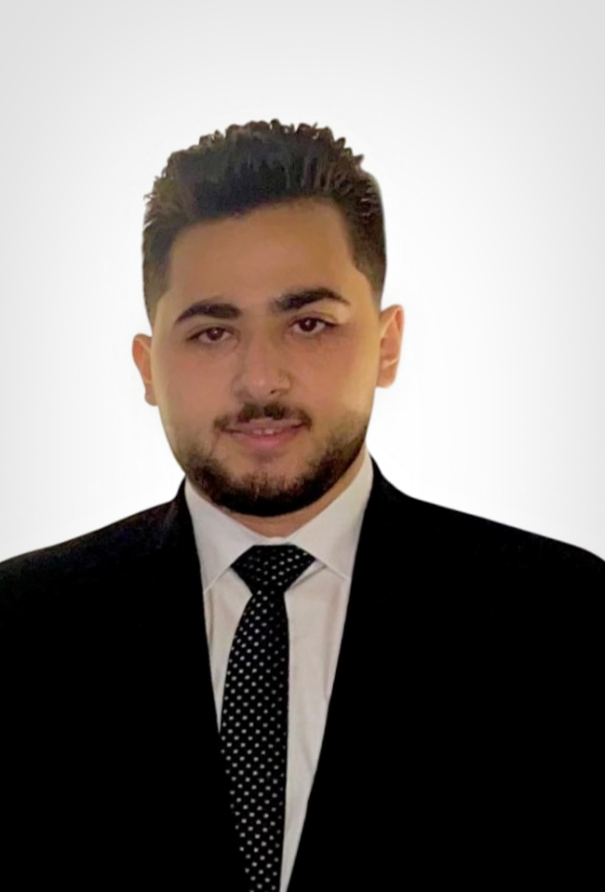
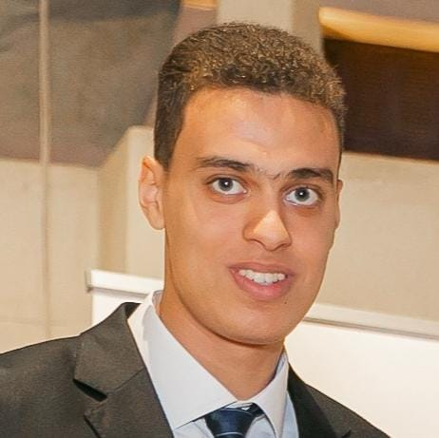


Our Team

Slide 4
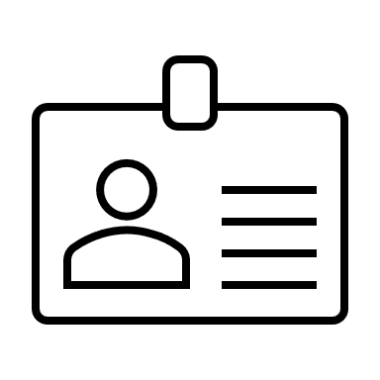


01
Introduction and Workflow
02
Hardware Components
Mobile Application
Agenda
03
04
Diagrams
05
Conclusion

Slide 5
01
Introduction and Workflow
02
Hardware Components
02
Suggested Application
Application Designs & methodology
03
03
Mobile Application
Agenda
04
Diagrams
04
Diagrams
05
Conclusion
05
Conclusion

Slide 6
Introduction: Why Stroke Prediction Matters
Global Impact
Better Outcomes with Early Warning
Reaching More People
Less Severe Strokes

Slide 7


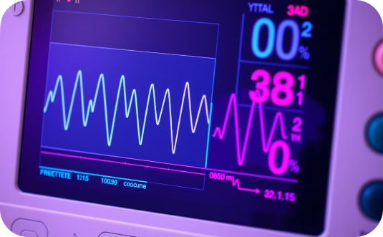
Introduction: Current Challenges in Healthcare
High costs of post-stroke care burden families and systems.
Many individuals lack access to early diagnostic tools.
Lack of real-time monitoring increases risk of complications.

Slide 8
Introduction: Advances in Technology
1
2
3
IoT's Rise
AI's Power
A Powerful Combination

Slide 9
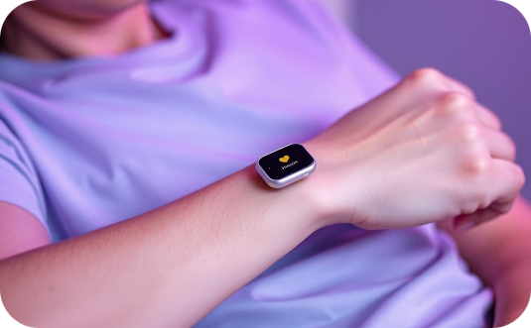
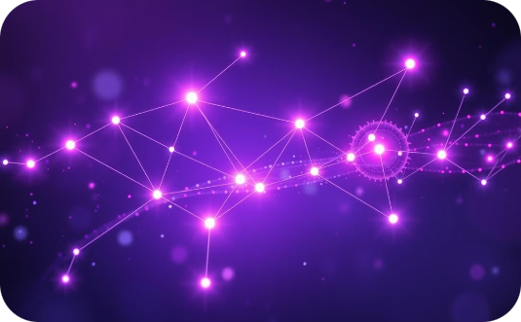
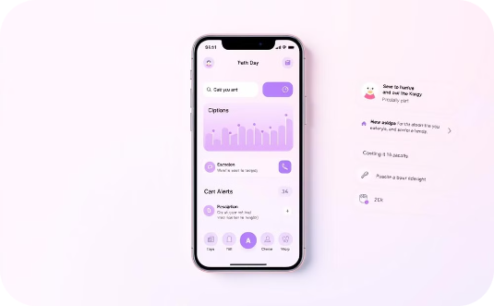
Introduction: Project Objectives
Portable Monitoring
AI-Powered Prediction
User-Friendly App
Convenient, non-invasive vital signs monitoring (heart rate, blood pressure, blood oxygen).
Employ AI to predict stroke risk using collected data, providing timely alerts.
User-friendly mobile app for data review, alerts, educational resources, and communication with healthcare providers.

Slide 10
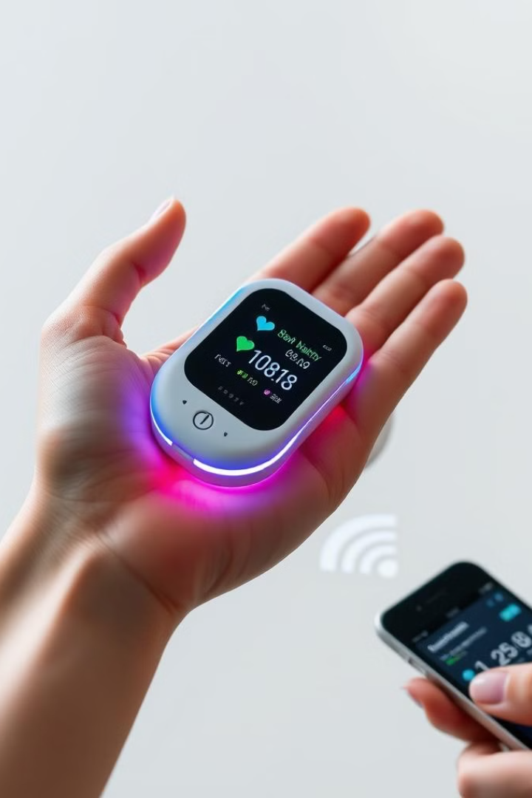
System Overview: Unique Features
Portable and Cost-Effective Design
AI-Driven Insights
Provides personalized health monitoring.
Ensures accessibility and affordability.
Seamless Integration
Hardware and software work together flawlessly.

Slide 11
Workflow: Step-by-Step Process
Sensors Capture Data
1
Heart rate, blood oxygen, and heart activity are measured and turned into digital signals.
2
Arduino Processes Data
The Arduino receives the data, cleans it up, does calculations, and prepares it for sending.
Data Transmission and Display
3
The data shows up on the screen and is sent wirelessly to your phone app.
4
Result Display
The app displays the analysis results from the AI model.
Data Storage
5
The app saves your data for later use.

Slide 12
01
01
Introduction and Workflow
Introduction and Workflow
02
02
Hardware Components
Suggested Application
Application Designs & methodology
03
03
Mobile Application
Agenda
04
Diagrams
04
Diagrams
05
Conclusion
05
Conclusion

Slide 13
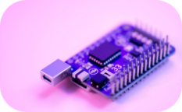
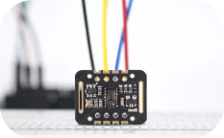
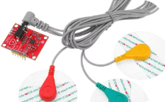
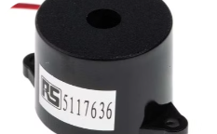
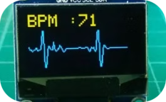
Hardware: Detailed Components
MAX30102 Sensor
ECG Sensor
Arduino Nano 33 IoT
Buzzer
OLED Display

Slide 14
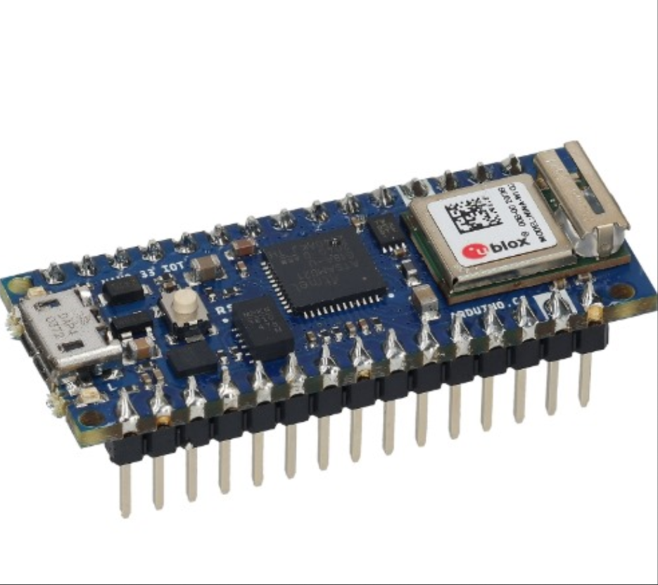
Arduino Nano 33 IoT
A small, powerful microcontroller board designed for IoT (Internet of Things) applications
It has built-in Wi-Fi and Bluetooth, making it perfect for connecting devices wirelessly

Slide 15
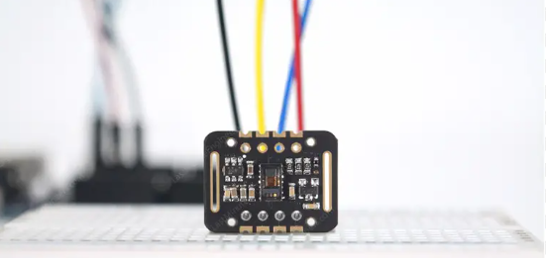
MAX30102 Sensor
A biometric sensor used to measure
heart rate and blood oxygen levels (SpO2).
Heart Rate (Pulse):
The normal resting heart rate for a healthy adult ranges between
60 to 100 beats per minute (BPM).
Oxygen Saturation (SpO2):
The normal oxygen saturation level for a healthy individual
is typically 95% to 100%.

Slide 16
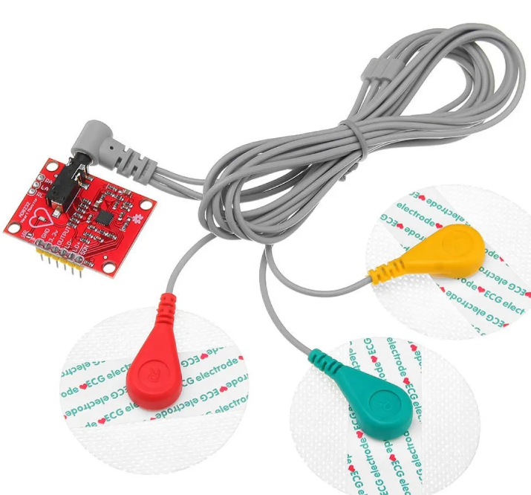
ECG Sensor (e.g., AD8232)
A sensor designed to capture electrical activity from the skin or body (such as ECG or muscle signals).

Slide 17
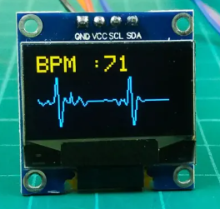
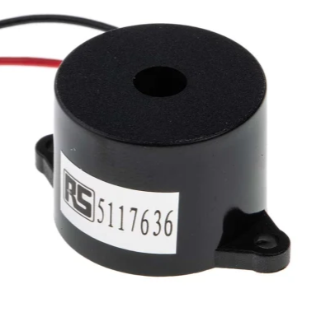
OLED Display
Displays heart rate and oxygen levels in real time.
Display the data coming from the ECG sensor.
Buzzer
A small electronic component that produces an audible sound.

Slide 18
01
01
Introduction and Workflow
Introduction and Workflow
02
Hardware Components
02
02
Hardware Components
Suggested Application
Mobile Application
Agenda
03
04
Diagrams
05
Conclusion

Slide 19
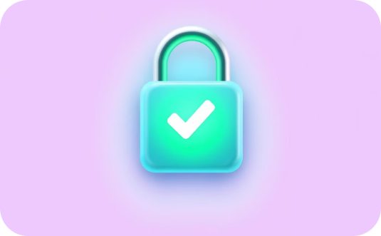
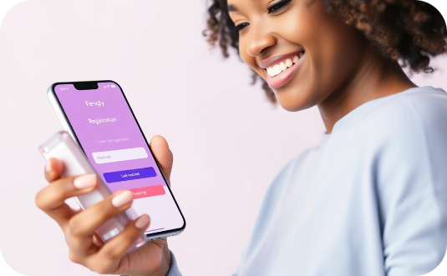

Mobile App: Login & Registration
Secure User Data
Intuitive Account Management
Privacy and Data Protection
Strong authentication protects user data.
Simple account creation and management.
We protect user privacy and follow strict data protection rules.

Slide 20




Mobile App: Homepage
Central Hub
Historical measurments
Quick Access
User-Friendly Design
Main access to all app features: data, history, communication.
One-tap access to chat and historical data.
Intuitive navigation, clean interface for ease of use.
Displays HR, SpO2, ECG; color-coded alerts for concerns.

Slide 21
Mobile App: Profile Management
Update Details
Medical History
Personalize App
Modify name, contact info, date of birth, and emergency contact.
Record past conditions, surgeries, allergies, and medications.
Configure notifications and reminders for health updates.

Slide 22

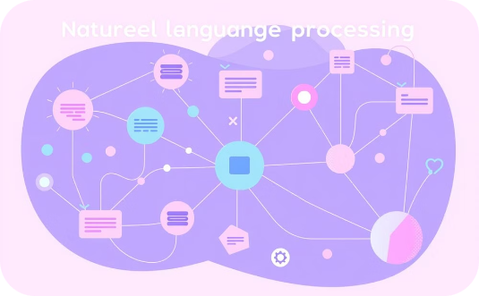
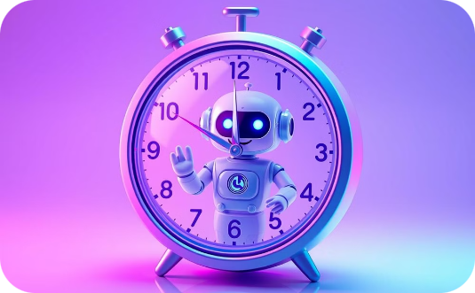
Mobile App: Chatbot
Personalized Advice
Advanced NLP
24/7 Availability
Offers personalized medical advice and stroke prevention tips.
Powered by advanced NLP for accurate responses.
Offers 24/7 support.

Slide 23
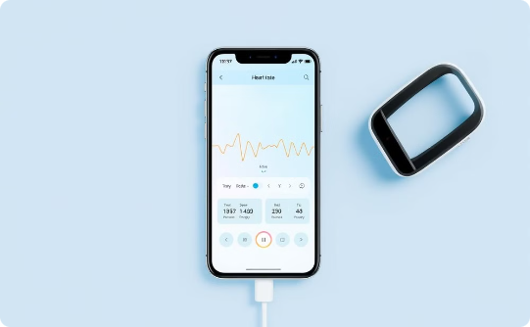
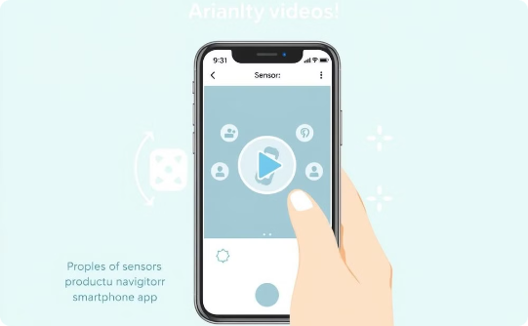
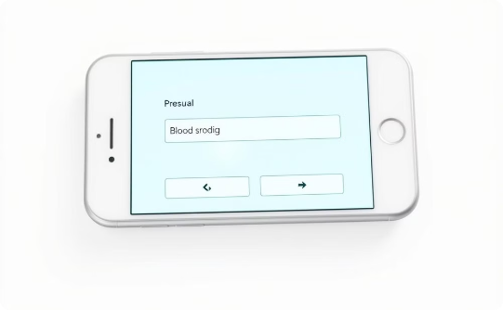
Mobile App: Measure Page
Bluetooth Integration
Video Tutorial
Manual Data Entry
Connect to hardware for live measurements.
Learn proper sensor placement and app navigation.
Input blood pressure data for a comprehensive profile.

Slide 24
01
01
Introduction and Workflow
Introduction and Workflow
02
Hardware Components
02
02
Hardware Components
Suggested Application
Mobile Application
03
Agenda
03
Mobile Application
04
Diagrams
04
Diagrams
05
Conclusion

Slide 25
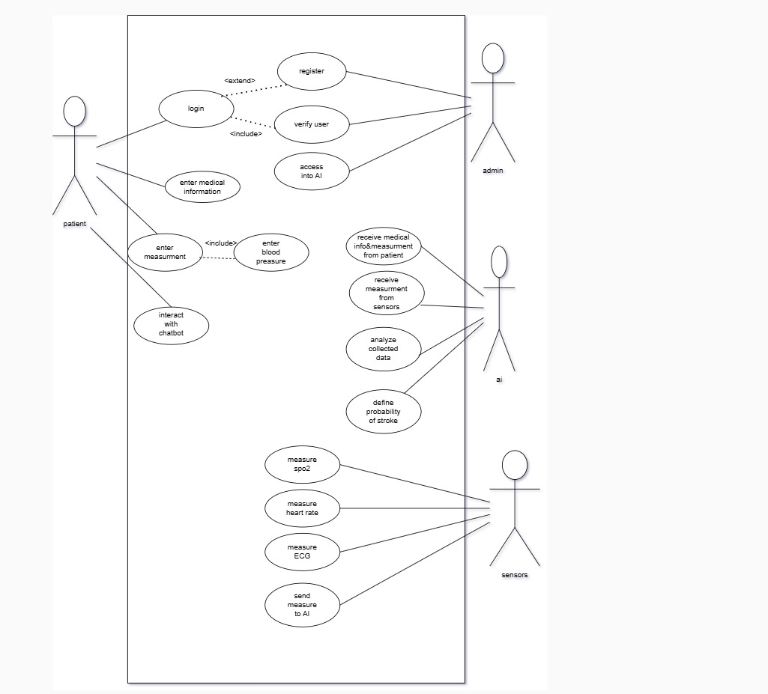
Use case Diagram

Slide 26
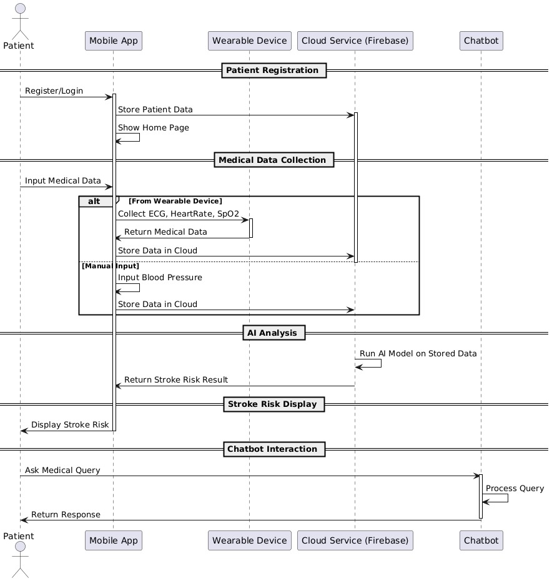
Sequence Diagram

Slide 27
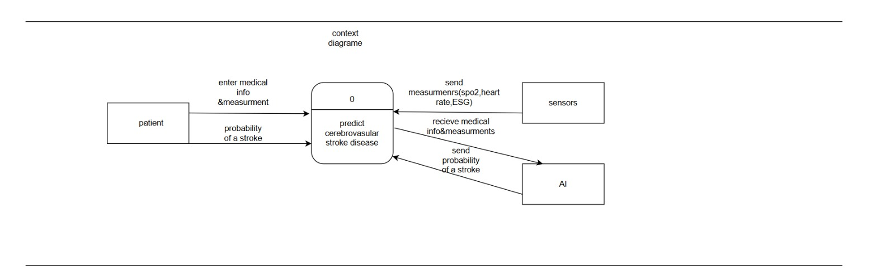
Data Flow Diagram (DFD ) Context Diagram

Slide 28
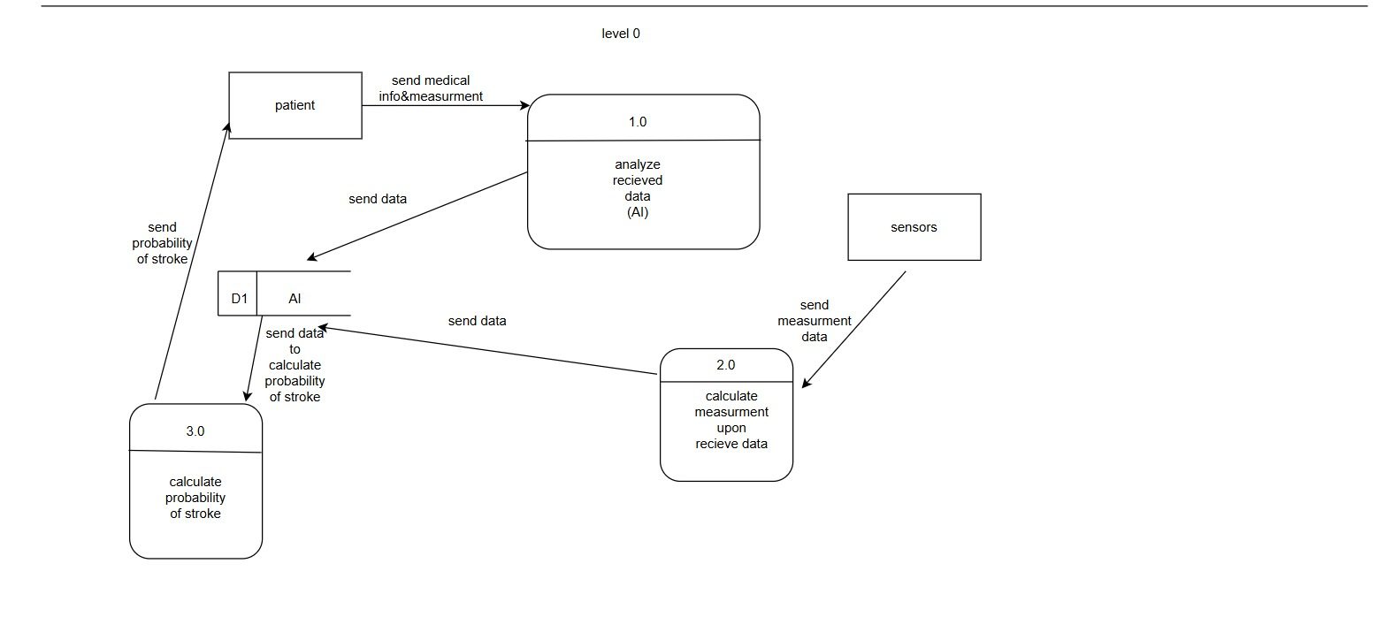
Data Flow Diagram (DFD) Level 0

Slide 29
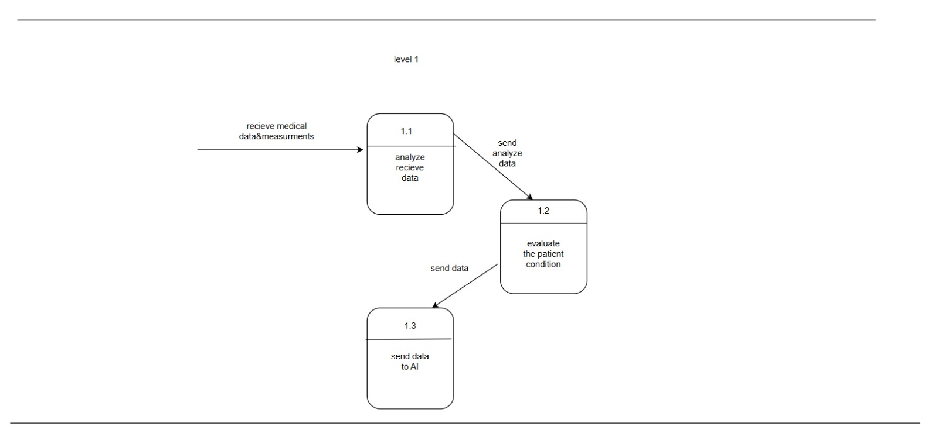
Data Flow Diagram (DFD) Level 1

Slide 30
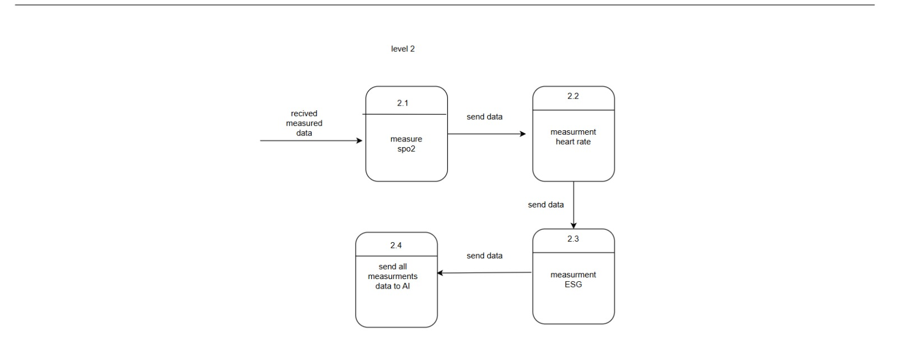
Data Flow Diagram (DFD) Level 2

Slide 31
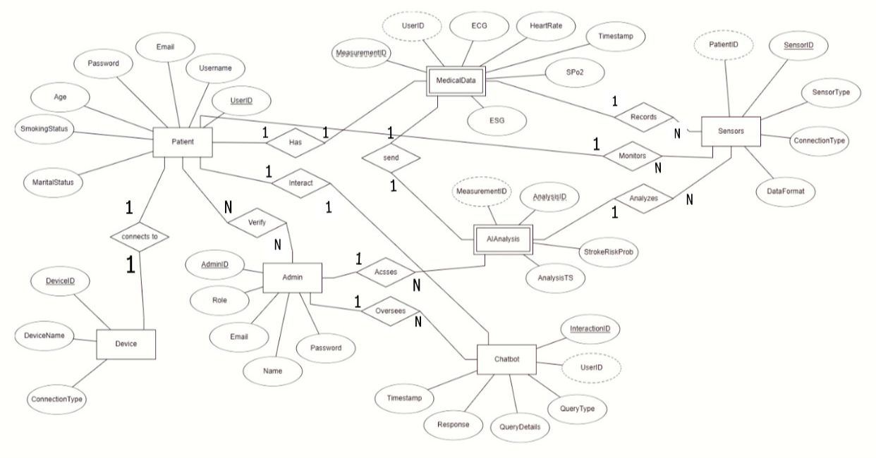
ERD Diagram

Slide 32
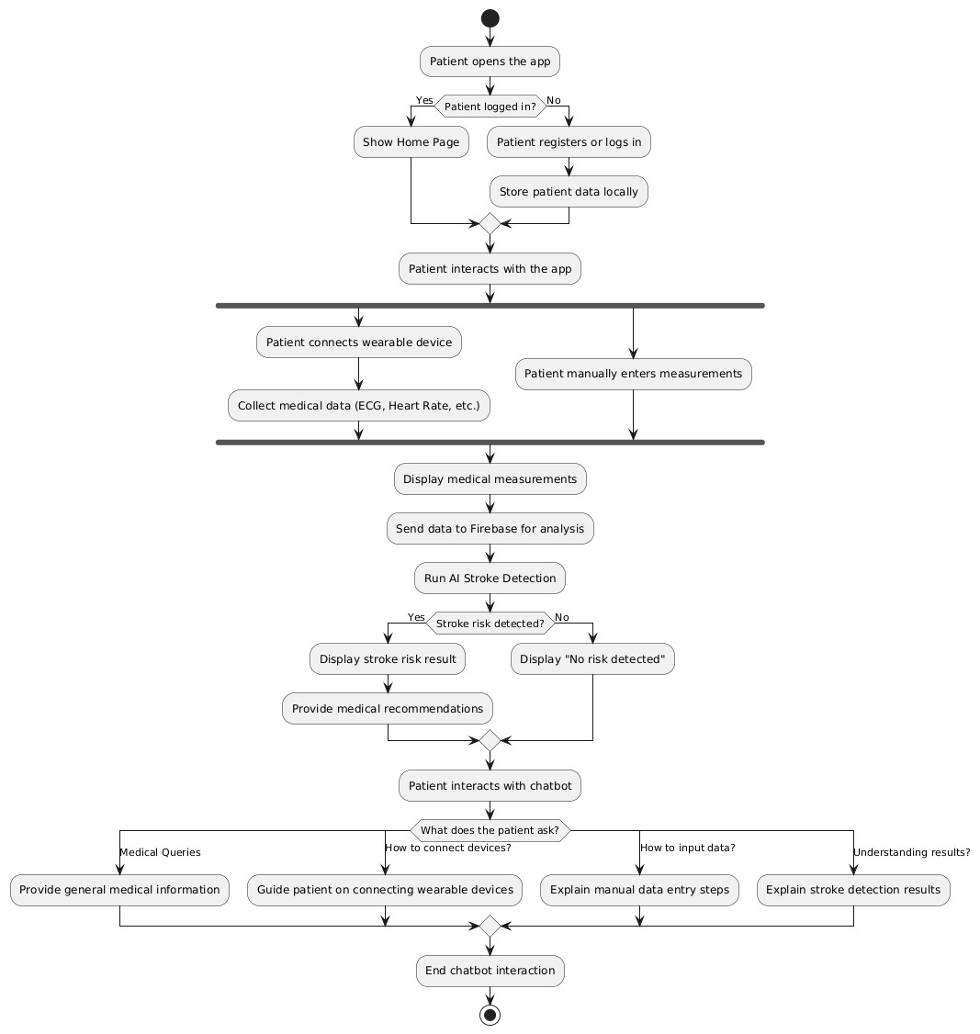
Patient Activity Diagram

Slide 33
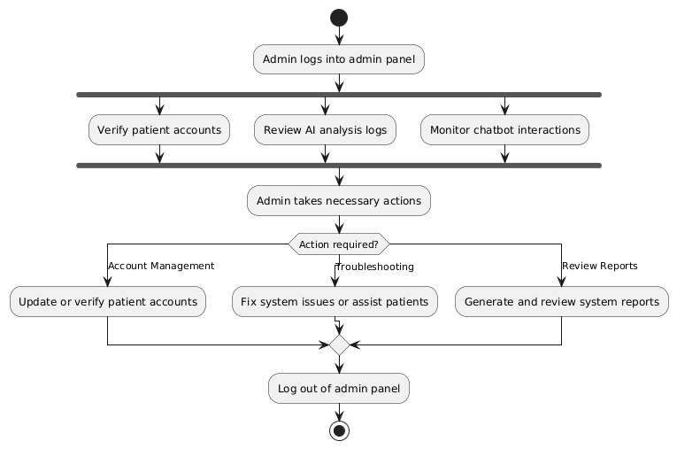
Admin Activity Diagram

Slide 34
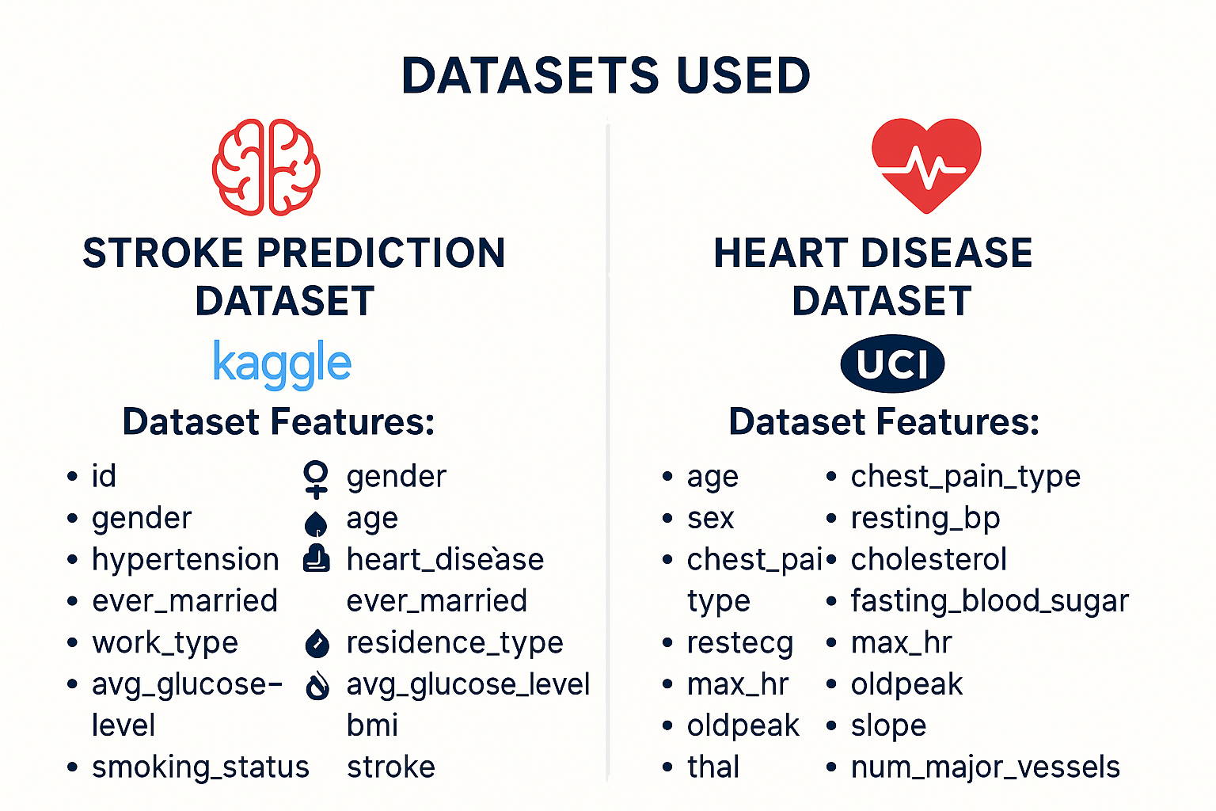

Slide 35
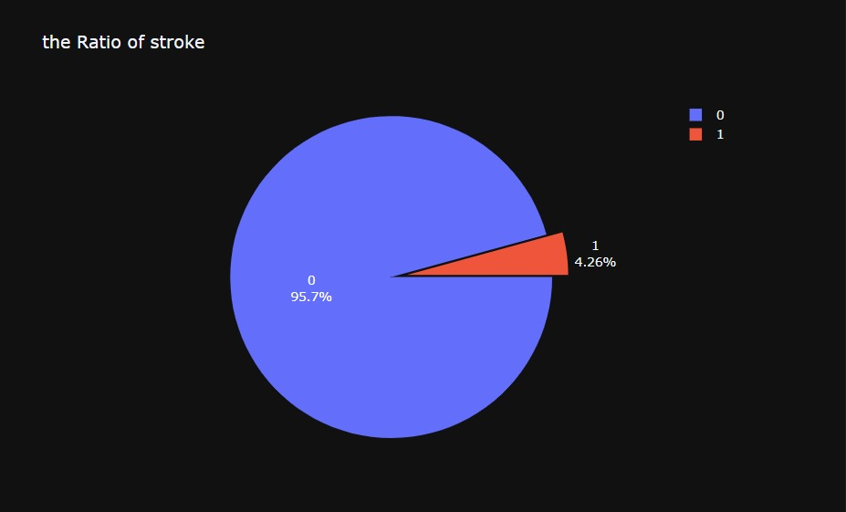
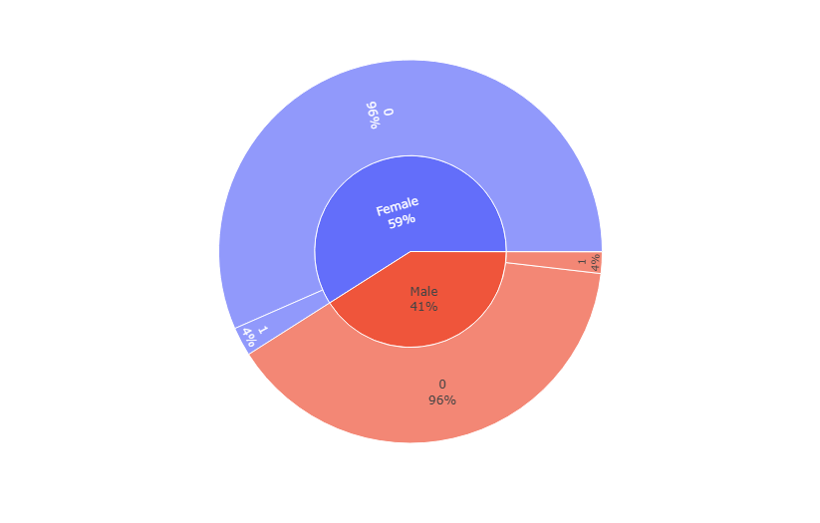
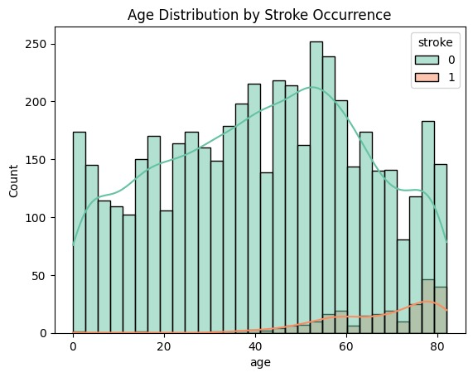
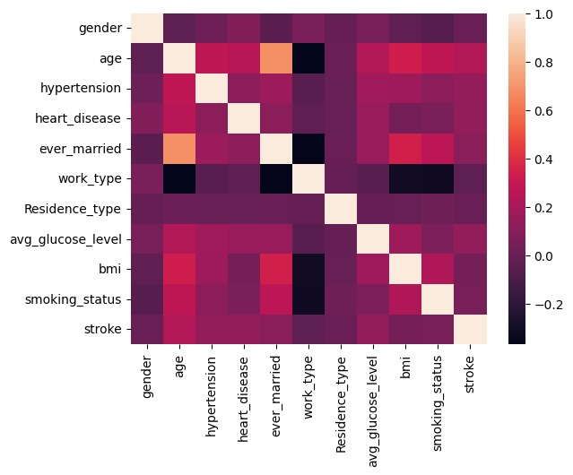
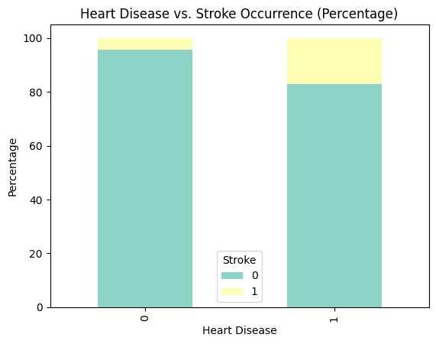
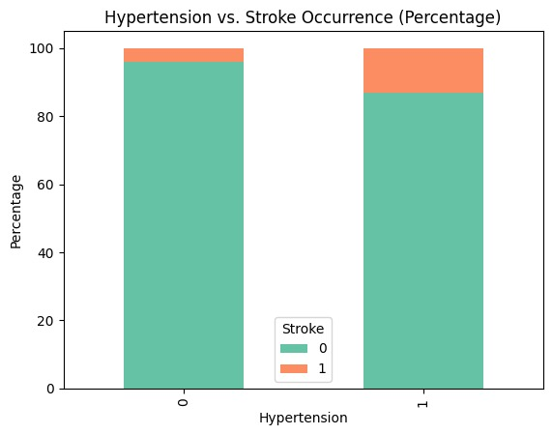
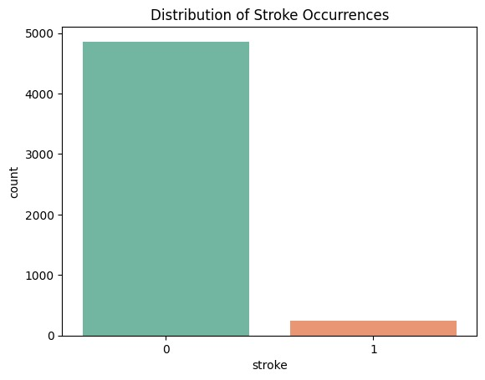
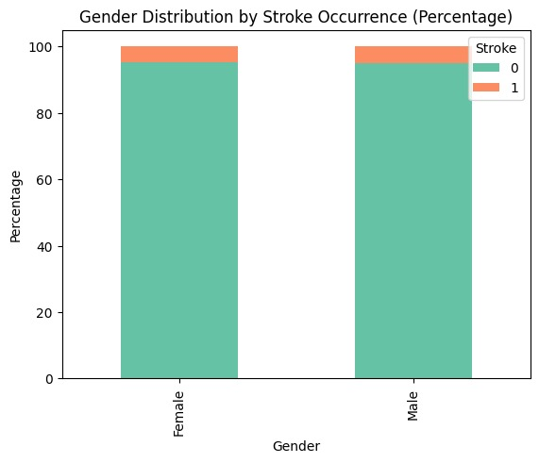
Exploratory Data Analysis
What is the relationship between hypertension and stroke?
How does heart disease relate to stroke occurrence?
What is the distribution of stroke occurrences?
Is there a gender difference in stroke occurrence?
How does age distribution differ between those who had a stroke and those who didn’t?
distribution of stroke
1
distribution Gender With Stroke
2
Age distribution With Stroke
3
Hypertension
4
Heart Disease
5
Heatmap Correlation
6

Slide 36
Model Architecture
exang
Max hr
restecg
Resting blood pressure
Work
Type
Ever
Married
Avg Glucose Level
oldpeak
Chest pain type
hypertension
BMI
slope
Sex
Gender
thal
Smoking Status
Heart Model
Age
Stroke Model
Stroke prediction
Heart disease

Slide 37
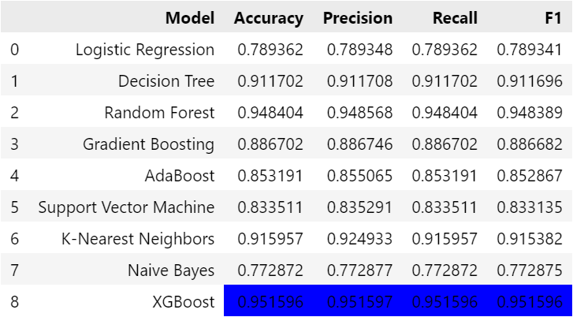
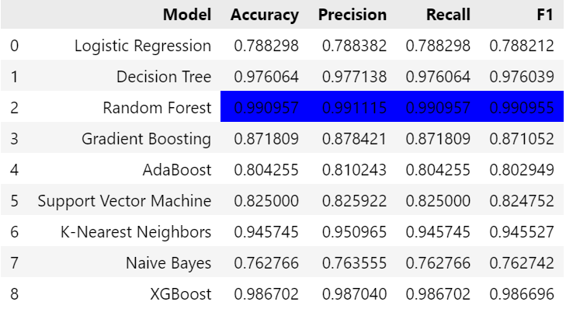
Solution to Deal with Imbalanced Data
Resampling data by SMOTE
Random Oversampling

Slide 38
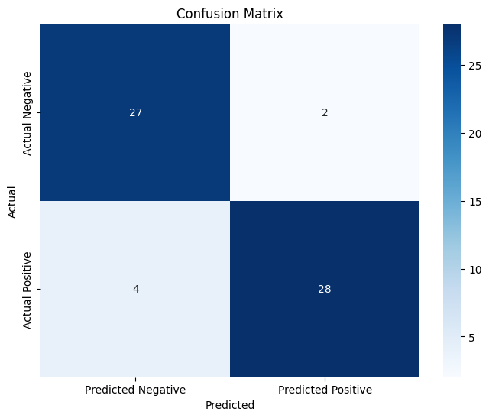
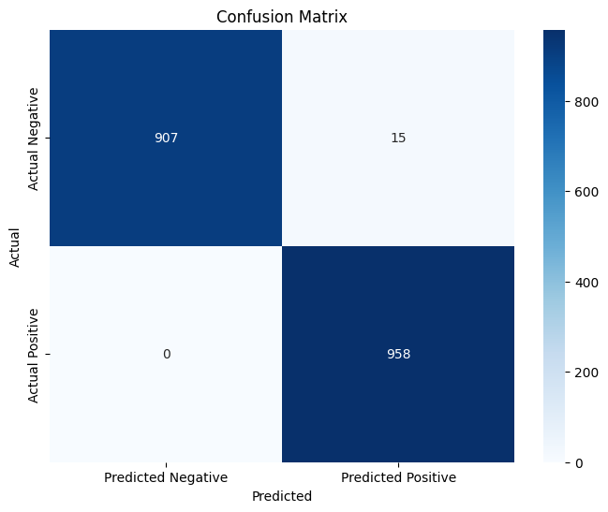
Results of Models
Heart disease Model
Stroke disease Model

Slide 39


Chatbot Fine-Tuning

Slide 40

Computer Vision Model

Slide 41


Slide 42


Results of Computer Vision Model
Main Model
Sub Model

Slide 43
01
01
Introduction and Workflow
Introduction and Workflow
02
Hardware Components
02
02
Hardware Components
Suggested Application
Mobile Application
03
Agenda
03
Mobile Application
04
Diagrams
05
Conclusion

Slide 44
Conclusion
We plan to launch our application on Google Play, aiming for positive feedback and a broad
impact on stroke prediction and prevention.
We would also like to extend our heartfelt thanks to Dr. Hussam Elbehiery
for his invaluable guidance throughout this project."

Slide 45
THANK YOU

